Slide 1

INFO 7225 Module 1
1. Introduction to Accounting
2. Accounting Information Flow
3. Financial Statements
Professor Shiaoming Shi
College of Engineering
Northeastern University

Slide 2
DEFINE ACCOUNTING
AND ITS PURPOSES

Slide 3
Structure of an Organization
Internal:
Owners/Management
Employees
Stakeholders
External:
Investors/Creditors
Customers
Regulators
Organization
Economic Activities

Slide 4
Roles of Accounting
Internal:
Owners/Management
Employees
Stakeholders
Decision Making
External:
Investors/Creditors
Customers
Regulators
Financial and managerial accounting
Organization
Economic Activities
Identifying, measuring, recording, and communicating an organization's economic activities to users

Slide 5
Accounting Defined
Accounting is the process of identifying, measuring, recording, and communicating an organization's economic activities to users.
Users need information for decision making.
Internal users of accounting information work for the organization and are responsible for planning, organizing, and operating the entity. The area of accounting known as managerial accounting serves the decision-making needs of internal users.
External users do not work for the organization and include investors, creditors, labor unions, and customers. Financial accounting is the area of accounting that focuses on external reporting and meeting the needs of external users.
This module addresses financial accounting. Managerial accounting will be covered in module 2.

Slide 7
ORGANIZATION STRUCTURE FOR ACCOUNTING AND FINANCE ACTIVITY

Slide 8
Common Computerized Accounting Systems
QuickBooks
Designed for small organizations
SAP and Oracle
Designed for large and/or multinational organizations
Customized to meet the unique informational needs of the entity

Slide 9
Accounting Information System:
The key functions performed by an accounting information system

Slide 10
Overall Structure of Module 1
By the end of this module, you will understand:
How the accounting information is being analyzed and processed;
How an accounting cycle is initiated and concluded
How financial statements are prepared; and
How business insights can be obtained from the output
The basics:
GAAP
Major classes of accounts
Accounting documents
Accounting equation
Double-entry book-keeping system
The financial statements
Generally Accepted Accounting Principles (GAAP)

Slide 11
Overall Structure of Module 1
By the end of this module, you will understand:
How the accounting information is being analyzed and processed;
How an accounting cycle is initiated and concluded
How financial statements are prepared; and
How business insights can be obtained from the output
The basics:
GAAP
Major classes of accounts
Accounting documents
Accounting equation
Double-entry book-keeping system
The financial statements
The accounting cycle:
Analyze and process the accounting information

Slide 12
Overall Structure of Module 1
By the end of this module, you will understand:
How the accounting information is being analyzed and processed;
How an accounting cycle is initiated and concluded
How financial statements are prepared; and
How business insights can be obtained from the output
Preparing financial statements:
Income Statement
Statement of Shareholders’ Equity
Balance Sheet
Statement of Cash Flows

Slide 13
Overall Structure of Module 1
By the end of this module, you will understand:
How the accounting information is being analyzed and processed;
How an accounting cycle is initiated and concluded
How financial statements are prepared; and
How business insights can be obtained from the output
Preparing financial statements:
Income Statement
Statement of Shareholders’ Equity
Balance Sheet
Statement of Cash Flows
Financial statement analysis:
Liquidity
Solvency
Efficiency
Profitability

Slide 14
Generally Accepted Accounting Principles (GAAP)

Slide 15
Accounting Information Must Possess the Quality of:
Relevance
Has the ability to make a difference in the decision-making process
Verifiability
Others are able to confirm that the information faithfully represents the economic activities of the business
Faithful representation
Is complete, neutral, and free from error
Timeliness
Is available to decision makers in time to be useful
Comparability
Tells users of the information that businesses utilize similar accounting practices
Understandability
Is clear and concise

Slide 16
GAAP Accounting Standards Connection Tree

Slide 17
GAAP Accounting Standards Connection Tree
A business may only report activities on financial statements that are specifically related to company operations, not those activities that affect the owner personally.
Assumes a business will continue to operate in the foreseeable future.
One should presume the business is doing well enough to continue operations unless there is evidence to the contrary.
What is “separate entity concept”?
What is “going concern assumption”?

Slide 18
GAAP Accounting Standards Connection Tree
In order to record a transaction, we need a system of monetary measurement, or a monetary unit by which to value the transaction.
In the United States, this monetary unit is the US dollar. Without a dollar amount, it would be impossible to record information in the financial records.
It also would leave stakeholders unable to make financial decisions, because there is no comparability measurement between companies.
This concept ignores any change in the purchasing power of the $ due to inflation (nominal units of money).
A company can present useful information in shorter time periods, such as years, quarters, or months.
The information is broken into time frames to make comparisons and evaluations easier.
What is “monetary measure. concept”?
What is “time period assumption”?

Slide 19
GAAP Accounting Standards Connection Tree
What is “revenue recognition principle”?
What is “cost principle”?
Directs a company to recognize revenue in the period in which it is earned; revenue is not considered earned until a product or service has been provided.
This means the period of time in which you performed the service/gave the customer the product is the period in which rev. is recognized.
No correlation between when cash is collected and when revenue is recognized.
aka the historical cost principle, states that virtually everything the company owns or controls (assets) must be recorded at its value at the date of acquisition.
Exceptions: financial instruments (recorded at their fair market value)

Slide 20
GAAP Accounting Standards Connection Tree
What is “full disclosure principle”?
What is “conservatism convention”?
States that a business must report any business activities that could affect what is reported on the financial statements.
These activities could be nonfinancial in nature or be supplemental details not readily available on the main financial statement.
Usually recorded in footnotes on the statements, or in addenda to the statements.
States that if there is uncertainty in a potential financial estimate, a company should err on the side of caution and report the most conservative amount.
Important when valuing a transaction for which the dollar value cannot be as clearly determined.

Slide 21
GAAP Accounting Standards Connection Tree
States that we must match expenses with associated revenues in the period in which the revenues were earned.
Also referred to as the matching principle
What is “expense matching principle”?

Slide 22
Five Classes of Accounts

Slide 23
Five Classes of Accounts
Assets
Liabilities
Equity
Revenues
Expenses

Slide 24
Five Classes of Accounts: Definition
Assets
Liabilities
Equity
Revenues
Expenses
What are liabilities?
________________
Probable future sacrifice of economic benefits arising from present obligations of a particular entity to transfer assets or provide services to other entities in the future as a result of past transactions or events
Current ______: debt or obligation due within one year or, in rare cases, a company’s standard operating cycle, whichever is greater
Non-current ________: _________ that is expected to be settled in more than one year

Slide 25
Five Classes of Accounts: Definition
What are assets?
______________
Tangible or intangible resource owned or controlled by a company, individual, or other entity with the intent that it will provide economic value
Current ___ = ___ that will be used or consumed in one year or less
Noncurrent ___ = ___ that will be used or consumed over more than one year
Assets
Liabilities
Equity
Revenues
Expenses
What is ?
_____________
Residual interest in the assets of an entity that remains after deducting its _____________.
_______________: corporation’s primary class of stock issued, with each share representing a partial claim to ownership or a share of the company’s business
_______________: cumulative, undistributed net income or net loss for the business since its inception.
= net income - dividends

Slide 26
Five Classes of Accounts: Definition
Assets
Liabilities
Equity
Revenues
Expenses
____________
Inflows or other enhancements of assets of an entity or settlements of its liabilities (or a combination of both) from delivering or producing goods, rendering services, or other activities that constitute the entity’s ongoing major or central operations
What are revenues?
What are expenses?
__________________
Cost associated with providing goods or services

Slide 27
Five Classes of Accounts: Examples
Assets
Liabilities
Equity
Revenues
Expenses
Accounts Payable (AP) |  | Land
Accounts Receivable (AR) |  | Notes Payable
Bonds Payable |  | Raw Material Expense
Building |  | Retained Earnings
Cash |  | Sales
Common Stock |  | Service Revenue
Equipment |  | Supplies
Fees Earned |  | Unearned Revenue
Prepaid Insurance |  | Utility
Interest payable |  | Wage Payable
Interest expense |  | Wage Expense
Inventory |  | Warranty Liability
2
1
1
2
2
5
1
3
1
4
3
4
1
1
4
2
1
5
2
2
5
5
1
2

Slide 28
Chart of Accounts (1)

Slide 29
Chart of Accounts (2)

Slide 30
Accounting Records:
Journals and Documents

Slide 31
Accounting Records: Journals
A journal is a chronological record of financial transactions.
Journal entry:
At some point during the transaction process, when all relevant facts about the transaction are known, the event is recorded in a journal in chronological order.
The primary sources of data entry into journals are documents.

Slide 32
Accounting Records: Documents
Product Documents
They are the result of transaction processing rather than the triggering mechanism for the process.
For example, a payroll check to an employee is a product document of the payroll system.
Source Documents
Economic events result in the creation of some documents at the beginning (the source) of the transaction.
These are called source documents and are used to capture and formalize transaction data that the transaction cycle uses for processing.
Turnaround Documents
Product documents of one system that become source documents for another system.

Slide 33
Example: Documents Used and Generated in a Sales Process
Source document:
_
Product document:
_
Turnaround document:
_

Slide 34
Two classes of Journals
General Journal
Firms use the general journal to record nonrecurring, infrequent, and dissimilar transactions.
For example, depreciation and closing entries are typically recorded in the ~
Special Journal
A journal used to record a large number of repetitive transactions such as
Credit sales, cash receipts, purchases, and cash disbursements

Slide 36
Special journal example: a sales journal

Slide 37
Accounting Records
Documents
Source documents
Product documents
Turnaround documents
Ledger (organized by accounts)
General ledger
A ledger that contains summary-level data for every asset, liability, equity, revenue, and expense account of the organization.
Examples: AR, AP
Subsidiary ledger
A ledger used to record detailed data for a general ledger account with many individual subaccounts
Breaks down certain general ledger accounts to provide more detailed information to users
Journal (chronological records)
General journal
Special journal

Slide 38
Accounting Information Flow / Steps in Accounting Process

Slide 39
The Accounting Equation

Slide 40
The accounting equation

Slide 42
Normal Balance of Major Accounts

Slide 43
A | LE - R | E
Assets and Expenses have what is known as a normal debit balance.
This simply means that the balance of that item will increase if it is debited, and it will decrease if it is credited.
Liabilities, Equity, and Revenue have normal credit balances.
This means that in order to increase any of these accounts, you would need to credit them.

Slide 44
The accounting equation
Transaction: a small business borrowed $2,000 from a local bank.

Slide 45
Normal balance of major accounts
Balance Sheet
Income Statement
Assets
Liabilities
Equity
Revenue
Expenses
DR CR DR CR DR CR DR CR DR CR
A | LE - R | E

Slide 46
Normal balance of major accounts
Balance Sheet
Income Statement
Assets
Liabilities
Equity
Revenue
Expenses
DR CR DR CR DR CR DR CR DR CR
A | LE - R | E

Slide 47
Contra Accounts
A contra account is an account that is related to another account and typically has an opposite normal balance that is subtracted from the balance of its related account on the financial statements.
Contra accounts to sales or revenue (contra revenue accounts):
Sales returns
Sale discounts
Allowance for doubtful accounts (a contra _______________ account)
Accumulated depreciation (a contra _______________ account)
accounts receivable
fixed assets

Slide 48
Financial Statements

Slide 49
The Income Statement

Slide 50
The Income Statement

Slide 51
The Income Statement

Slide 52
Statement of Shareholders’ Equity

Slide 53
Statement of Shareholders’ Equity

Slide 54
Statement of Shareholders’ Equity

Slide 55
Statement of Shareholders’ Equity

Slide 56
The Balance Sheet

Slide 57
The Balance Sheet

Slide 58
The Balance Sheet

Slide 59
Differentiate between operating, investing, and financing activities
💵
Provided by sales/revenue
Used in operations – expenses (vendors and employees) and inventory purchases
💵
Proceeds from the sale of fixed assets of other investments
Used in purchasing new equipment, facilities, and investing excess cash into investment vehicles
💵
Provided via borrowings or equity infusions from shareholders
Used for paying principal payments on debt owed and dividends or distributions paid out to shareholders

Slide 60
Relationships Among the Three Types of Business Activities

Slide 61
Statement of Cash Flows

Slide 62
Statement of Cash Flows
$
$

Slide 63
Statement of Cash Flows
$
$

Slide 64
Statement of Cash Flows
$
$

Slide 65
Summary
GAAP
Accounting records
Five classes of accounts
Accounting equation
Normal balance of each account
Four financial statements

Slide 66
INFO 7225 Module 1
4. Analyzing & Recording Transactions
Professor Shiaoming Shi
College of Engineering
Northeastern University

Slide 67
A practice quiz will be available from the Canvas “Quizzes”. Please complete it on time to get accustomed to the Canvas Quiz format. It will not be counted towards the final grade.

Slide 68
Analyzing and Recording
Business Transactions

Slide 69
Learning objectives
After completing this class, you should be able to
Analyze transactions using the accounting equation;
Record transactions in a general journal using the double-entry system;
Post journal information in a general ledger;
Prepare an unadjusted trial balance.

Slide 70
The accounting equation

Slide 71
Normal balance of major accounts

Slide 72
In-class exercise
Indicate the net effect (↑ for increase; ↓ for decrease; 0 for no effect) of each of the following transactions on each part of the accounting equation, Assets = Liabilities + Equity.
For example, for payment of an accounts payable balance, A (↓) = L (↓) + E (0)
Payment of principal balance of note payable A ( ) = L ( ) + E ( )
Purchase of supplies for cash A ( ) = L ( ) + E ( )
Payment of dividends to stockholders A ( ) = L ( ) + E ( )
Issuance of stock for cash A ( ) = L ( ) + E ( )
Billing customer for physician services provided A ( ) = L ( ) + E ( )

Slide 73
Record the debit and credit in the appropriate account for each of the following transactions:
# | Transaction Description | Debit | Credit
1 | Issued common stock for cash.
2 | Purchased equipment on credit.
3 | Paid for a one-year insurance policy.
4 | Billed a customer for repairs completed today.
5 | Paid this month’s rent.
6 | Collected the amount billed in transaction 4 above.
7 | Collected cash for repairs completed today.
8 | Paid for the equipment purchased in transaction 2 above.
9 | Signed a union contract.
10 | Collected cash for repairs to be made for customers next month.
11 | Transferred this month’s portion of prepaid insurance that was used to Insurance Expense.

Slide 74
Analyzing Business Transactions

Slide 75
Transactions summary:
Issued share capital for $10,000 cash.
Received a bank loan for $3,000.
Purchased equipment for $3,000 cash.
Purchased a truck for $8,000; paid $3,000 cash and incurred a bank loan for the balance.
Paid $2,400 for a comprehensive one-year insurance policy effective January 1.
Paid $2,000 cash to reduce the bank loan.
Received $400 as an advance payment for repair services to be provided over the next two months as follows: $300 for February, $100 for March.
Performed repairs for $8,000 cash and $2,000 on credit.
Paid a total of $7,100 for operating expenses incurred during the month; also incurred an expense on account for $700.
Dividends of $200 were paid in cash to the only shareholder, Bob Baldwin.
Transaction #
Effect on the Accounting Equation
 | Asset | = | Liabilities | + | Equity
1
2
3
4
5
6
7
8
9
10

Slide 78
Recording Transactions
in the General Journal

Slide 79
Transactions summary:
Issued share capital for $10,000 cash.
Received a bank loan for $3,000.
Purchased equipment for $3,000 cash.
Purchased a truck for $8,000; paid $3,000 cash and incurred a bank loan for the balance.
Paid $2,400 for a comprehensive one-year insurance policy effective January 1.
Paid $2,000 cash to reduce the bank loan.
Received $400 as an advance payment for repair services to be provided over the next two months as follows: $300 for February, $100 for March.
Performed repairs for $8,000 cash and $2,000 on credit.
Paid a total of $7,100 for operating expenses incurred during the month; also incurred an expense on account for $700.
Dividends of $200 were paid in cash to the only shareholder, Bob Baldwin.
General Journal Page #
Date |  | Description | R | Debit | Credit
2015
Jan. | 1
 | 2
 | 2
To record
To record
To record the purchase of equipment for cash.

Slide 80
Transactions summary:
Issued share capital for $10,000 cash.
Received a bank loan for $3,000.
Purchased equipment for $3,000 cash.
Purchased a truck for $8,000; paid $3,000 cash and incurred a bank loan for the balance.
Paid $2,400 for a comprehensive one-year insurance policy effective January 1.
Paid $2,000 cash to reduce the bank loan.
Received $400 as an advance payment for repair services to be provided over the next two months as follows: $300 for February, $100 for March.
Performed repairs for $8,000 cash and $2,000 on credit.
Paid a total of $7,100 for operating expenses incurred during the month; also incurred an expense on account for $700.
Dividends of $200 were paid in cash to the only shareholder, Bob Baldwin.
General Journal Page #
Date |  | Description | R | Debit | Credit
 | 3
 | 5
To record the purchase of a truck for cash and bank loan.
To record payment of a one-year insurance policy.
10
To record payment on bank loan.
15
To record receipt of payment for service not yet performed:
$300 for February, $100 for March.

Slide 81
Transactions summary:
Issued share capital for $10,000 cash.
Received a bank loan for $3,000.
Purchased equipment for $3,000 cash.
Purchased a truck for $8,000; paid $3,000 cash and incurred a bank loan for the balance.
Paid $2,400 for a comprehensive one-year insurance policy effective January 1.
Paid $2,000 cash to reduce the bank loan.
Received $400 as an advance payment for repair services to be provided over the next two months as follows: $300 for February, $100 for March.
Performed repairs for $8,000 cash and $2,000 on credit.
Paid a total of $7,100 for operating expenses incurred during the month; also incurred an expense on account for $700.
Dividends of $200 were paid in cash to the only shareholder, Bob Baldwin.
General Journal Page #
Date |  | Description | R | Debit | Credit
31
To record repair revenue eared in January.
31
To record expenses incurred and cash payment of exp. in Jan.
31
To record distribution of dividends.

Slide 82
Recording Transactions in the General Journal

Slide 85
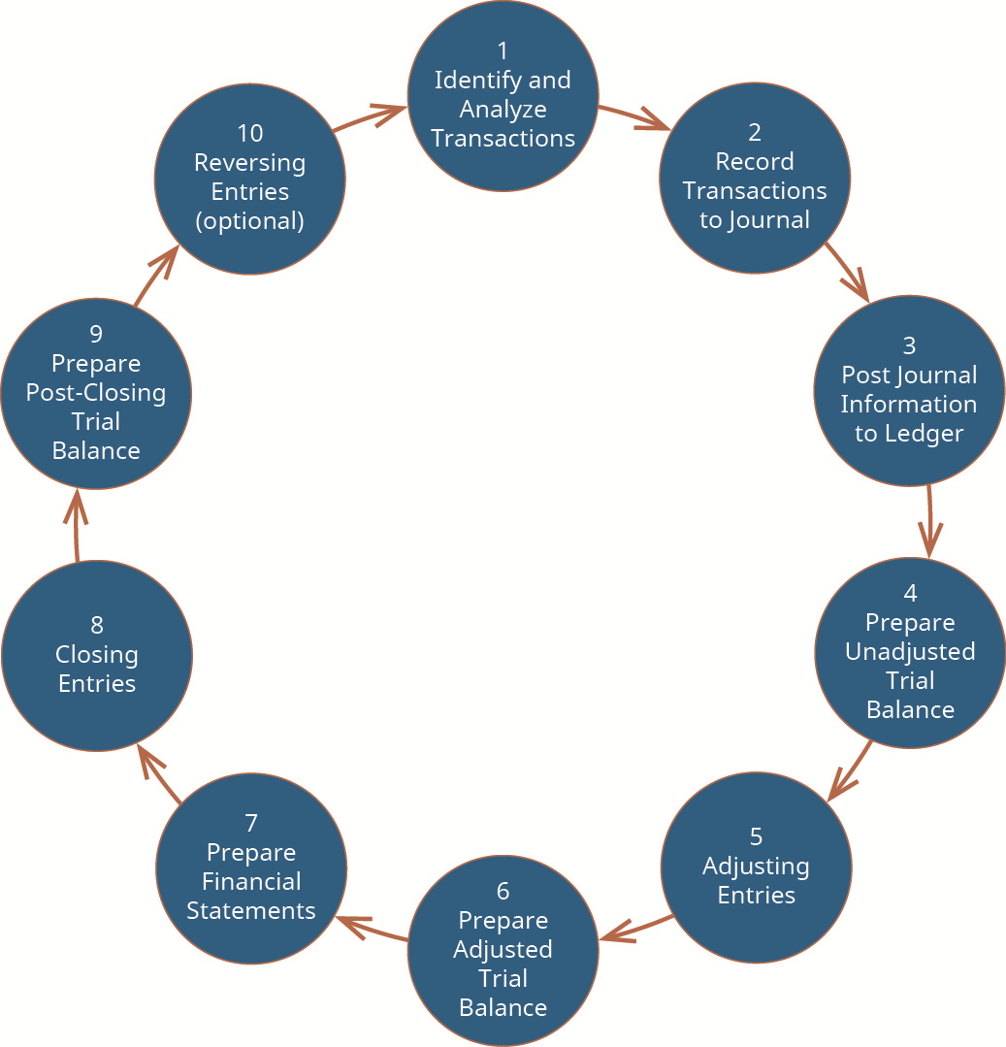
The Accounting Cycle
Steps 1 & 2:
Transactions are analyzed and journalized.
Journalizing consists of analyzing transactions as they occur to see how they affect the accounting equation.
Then, the transactions are recorded chronologically in the general journal.
Step 3:
Transactions are summarized by account.
Posting consists of transferring debits and credits from the general journal to the appropriate general ledger accounts.

Slide 86
Posting Journal Information
to General Ledger

Slide 87
Accounting Records
Documents
Source documents
Product documents
Turnaround documents
Ledger (organized by accounts)
General ledger
A ledger that contains summary-level data for every asset, liability, equity, revenue, and expense account of the organization.
Examples: AR, AP
Subsidiary ledger
A ledger used to record detailed data for a general ledger account with many individual subaccounts
Breaks down certain general ledger accounts to provide more detailed information to users
Journal (chronological records)
General journal
Special journal

Slide 88
Transaction summaries from the special journals, and all transactions in the general journal are posted to the general ledger

Slide 89
General Ledger in T-account Form
Assets
Liabilities
Equity
Revenue
Expenses

Slide 90
Example 1 Record Transaction and Post Information to T-accounts
Prepare journal entries to record the following transactions. Create a T-account for Cash, post any entries that affect the account, and calculate the ending balance for the account. Assume a Cash beginning balance of $37,400.
May 12, collected balance due from customers on account, $16,000
June 10, purchased supplies for cash, $4,400
Date | Description | Debit | Credit
Cash

Slide 91
Example 2 record transaction and post information to t-accounts
Prepare journal entries to record the following transactions. Create a T-account for Accounts Receivable and Cash, post any entries that affect the account, and calculate the ending balance for the account (assume no beginning balance).
Provided legal services to customers for cash, $5,600
Provided legal services to customers on account, $4,700
Collected cash from customer accounts, $3,500
Date | Description | Debit | Credit
Accounts Receivable
Cash

Slide 92
Transactions summary:
Issued share capital for $10,000 cash.
Received a bank loan for $3,000.
Purchased equipment for $3,000 cash.
Purchased a truck for $8,000; paid $3,000 cash and incurred a bank loan for the balance.
Paid $2,400 for a comprehensive one-year insurance policy effective January 1.
Paid $2,000 cash to reduce the bank loan.
Received $400 as an advance payment for repair services to be provided over the next two months as follows: $300 for February, $100 for March.
Performed repairs for $8,000 cash and $2,000 on credit.
Paid a total of $7,100 for operating expenses incurred during the month; also incurred an expense on account for $700.
Dividends of $200 were paid in cash to the only shareholder, Bob Baldwin.

Slide 93
ASSETS
LIABILITIES
EQUITY
REVENUE
EXPENSES

Slide 94
Recording Transactions in the General Journal

Slide 97
Cash
Bank Loan (Notes Payable)

Slide 98
Transactions Posted to two accounts in the General Ledger (formal variation of the t-account)

Slide 99
The Accounting Cycle
Steps 1 & 2:
Transactions are analyzed and journalized.
Journalizing consists of analyzing transactions as they occur to see how they affect the accounting equation.
Then, the transactions are recorded chronologically in the general journal.
Step 3:
Transactions are summarized by account.
Posting consists of transferring debits and credits from the general journal to the appropriate general ledger accounts.
Step 4:
Prepare unadjusted trial balance

Slide 100
Prepare Unadjusted Trial Balance
Purpose: start of financial statements preparation
Purpose: help prove the accounting equation is in balance
The account balances in the ________ ________ are used to prepare the trial balance.
The trial balance is an internal report that lists all the account balances ________________.
The total debits must equal total credits on the trial balance.
The (adjusted) trial balance is used in the preparation of financial statements.

Slide 101
Example 3 Prepare an unadjusted trial balance
Prepare an unadjusted trial balance, in correct format, from the alphabetized account information from the ledger accounts summarized as follows. Assume all accounts have normal balances.
Account | Debit | Credit
Total

Slide 102
Transactions summary:
Issued share capital for $10,000 cash.
Received a bank loan for $3,000.
Purchased equipment for $3,000 cash.
Purchased a truck for $8,000; paid $3,000 cash and incurred a bank loan for the balance.
Paid $2,400 for a comprehensive one-year insurance policy effective January 1.
Paid $2,000 cash to reduce the bank loan.
Received $400 as an advance payment for repair services to be provided over the next two months as follows: $300 for February, $100 for March.
Performed repairs for $8,000 cash and $2,000 on credit.
Paid a total of $7,100 for operating expenses incurred during the month; also incurred an expense on account for $700.
Dividends of $200 were paid in cash to the only shareholder, Bob Baldwin.
Big Dog Carworks Corp.
Unadjusted Trial Balance
At January 31, 2015
Acct. Account Debit Credit
101 Cash $3,700
Accounts receivable 2,000
161 Prepaid insurance 2,400
183 Equipment 3,000
Truck 8,000
201 Bank loan $6,000
210 Accounts payable 700
247 Unearned revenue 400
320 Share capital 10,000
330 Dividends 200
450 Repair revenue 10,000
654 Rent expense 1,600
656 Salaries expense 3,500
668 Supplies expense 2,000
670 Truck operation expense 700
$27,100 $27,100

Slide 103
summary
Companies record transactions in a general journal, a document which chronologically lists each debit and credit journal entry.
To summarize the debit and credit entries by account, the entries in the general journal are posted (or transferred) to the general ledger.
To help prove the accounting equation is in balance, a trial balance is prepared.
The account balances in the general ledger are used to prepare the trial balance.
The trial balance is an internal report that lists all the account balances at a point in time.
The total debits must equal total credits on the trial balance.
The (adjusted) trial balance is used in the preparation of financial statements.

Slide 104
Thank you!
Questions?

